Slide 1
Analysis on Ski Resorts.
Big Mountain Resorts

Slide 2
Problem Statement Worksheet (Hypothesis Formation)
Big Mountain Resorts want to increase their revenue in span of an year (Dec 2021) as to meet the new expenditure on installing new chair lift by altering the resort's pricing strategy. Either by undermining pricing to market segments and attract more visitors or increase ticket prices.
H
1
Context
4
Constraints within solution space
Big Mountain Resorts, a ski resort located in montana. It is a premium resort with spectacular views of Glacier National park and FlatHead National Forest and nearly 350k people ski here yearly.Adding to these, it has 11 lifts, 2 T-bars and a magic carpet with base elevation of 4,464ft.
Being a premium resort, they installed an additional chair lift to attract more visitors which costed nearly $1.5 million the present season
Asking the customers to pay a premium price when compared to other competitors in market can be potential threat if we are not showing any USP to customers. Because there’s already a word out about resort not utilizing the location advantage that it has over other competitors.
5
Stakeholders to provide key insight
2
Criteria for success
Jimmy Blackburn - Director of Operations
Alesha Eisen - Database Manager
Increase the revenue by 1 million by december 2021.
Increase the number of people visiting or skiing by 15% so that the number people that ski or snowboard yearly would hit 400K mark.
3
Scope of solution space
6
Key data sources
Big mountain has 105 trails in which we need to analyse on which trails are of least interest for skiers in order count them down to reduce maintenance costs.
Explore Chair lift data to get more insights like time taken for one trip, number of trips per day, cost per trip etc., for better understanding on how beneficial is new chair lift that’s installed.
User Level access to SQL Database or S3 bucket
A CSV file provided by database Manager (Alesha Eisen).
H
Notes:
Hypothesis: Create a Hypothesis with an emphasis on SMART principles. (S – Specific, M – Measurable, A – Achievable, R – Realistic, T – Timebound). If you cannot do this, you do not have a good grasp on the business problem.
Context: With context, we have clearly identified the problem at hand and have elucidated on how our initiative may solve this problem, alongside the commercial implications this will have on the business.
Criteria for Success: Clearly defining the criteria for success ensures that the scope of your work is clearly defined and understood. Otherwise, if this isn’t defined – your work will never end which will result in mismatched expectations.
Scope of Solution Space: Scoping out the solution space ensures that the business initiative is SPECIFIC for a certain segment or area. This prevents solutions that have been developed being scaled and applied for all other business units that the solution may not be responsible or scalable for.
Constraints within Solution Space: Looking forward, what are the foreseeable problems we are likely to encounter? Could this be stakeholder resistance? Could this be we don’t have access to the right data?
Stakeholders to provide key insight: Who are the people I need to speak to, to get the answers I need for my data analysis?
What key data sources are required?
Based off my discussions with the key stakeholders – can we clearly list out all the data sources we need so we can make a highly targeted request as opposed to a scatter-gun approach where we ask for a bit of everything?

Slide 3
Recommendations
Scenario | Impact
Close 10 least used Runs of the resort | Closing 1 will not affect ticket price but more than that would ask the company to take a dip in ticket price and in turn revenue.
increase vertical drop by 150 feet. installing an additional chair lift. Add a new Run | Supports an increase of $8.61 on current ticket price which helps an increase in revenue of more than $15 million.
Same as above with addition of the following. 4.) Add 2 acres of snow making. | Supports an increase of $9.90 on current ticket price which helps an increase in revenue of more than $17 million.
Increase Longest run by 0.2 miles. Increase snowmaking area by 4 acres | No Impact

Slide 4
Modeling Results and Analysis
The dependant features are “Adult Weekend” and “Adult Weekday”.
But, them being linear to each other we selected one column as taget variable which has less null values. That would be “Adult Weekend”.
We have made use of Linear Regression and RandomForestRegressor algorithms to find the best model suitable for data.
After analyzing performance metrics over both algorithms, Random Forest Regressor has shown mean absolute error nearly $1 less than Linear Regression. So, the model will be RandomForestRegressor.

Slide 5
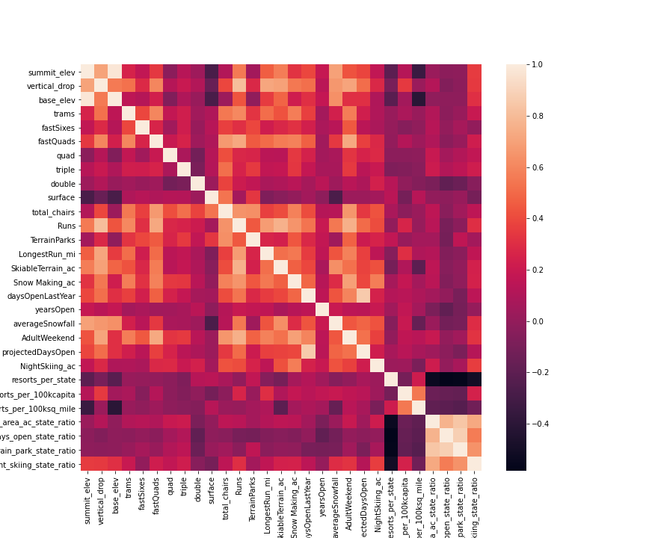
Analysis-Heat Map
There seems a strong relationship between base elevation and summit elevation.Adding to it, fastQuads,verticaldrop etc., might be potential positive predictors for AdultWeekend.

Slide 6
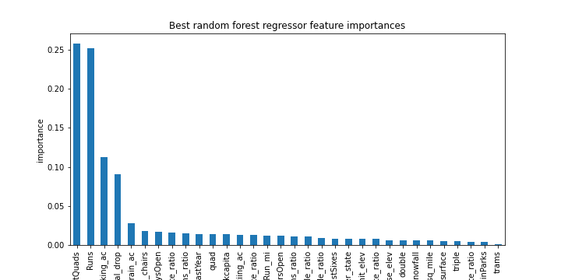
FEATURE ENGINEERING
The graph confirms that
FastQuads
Runs
Snow_making_ac
Vertical_drop
Are few independent variables that help us in finding the Ticket Price.

Slide 7
SUMMARY AND CONCLUSION
Scenario | Impact | Information | Verdict
Close 10 least used Runs of the resort | Closing 1 will not affect ticket price but more than that would ask the company to take a dip in ticket price and in turn revenue. | It would not increase the revenues just by cut downing maintenance cost of one run. | Not Recommended
increase vertical drop by 150 feet. installing an additional chair lift. Add a new Run | Supports an increase of $8.61 on current ticket price which helps an increase in revenue of more than $15 million. | There is a clear inference here with increase ticket rate buffer and revenue. | Highly Recommended.
Same as above with addition of the following. Add 2 acres of snow making. | Supports an increase of $9.90 on current ticket price which helps an increase in revenue of more than $17 million. | An increase in Pricing buffer but a small one when compared to investment to be done. | Good Choice
Increase Longest run by 0.2 miles. Increase snowmaking area by 4 acres | No Impact | No change | Highly Not Recommended

